Slide 1



Javier Conde Pascual | 14th April 2022
Course 3: Final Assignment Python/R Presentation
Javier Conde Pascual | 12th September 2022

Slide 2
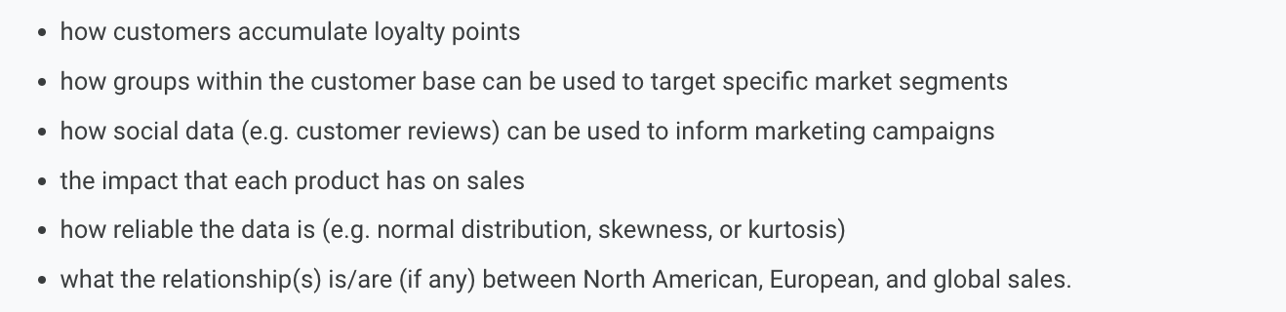
1. Scenario and system set up
Figure 1.1: Background, project goal and initial set of questions to answer
Source: LSE (2022)
ROLE: assuming the role of data analyst working with game manufacturer and retailer Turtle Games. Its product range includes books, board games, video games, and toys.
PROJECT GOAL: analyse available data from sales and customer reviews to extract and share insights with stakeholders. The ultimate target is improving overall sales performance by utilising customer trends.
INITIAL SET OF QUESTIONS:
Javier Conde | 12th September 2022

Slide 3
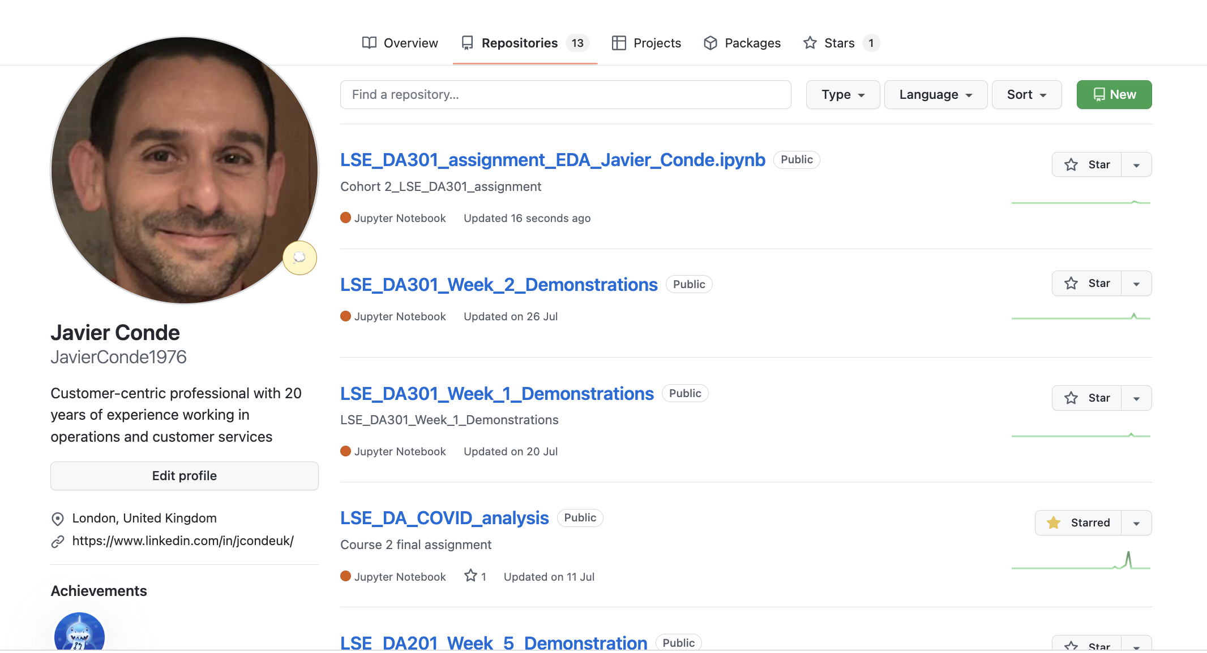
Figure 1.2: Project Github repository (I)
Source: Javier Conde (2022)
Javier Conde | 12th September 2022

Slide 4
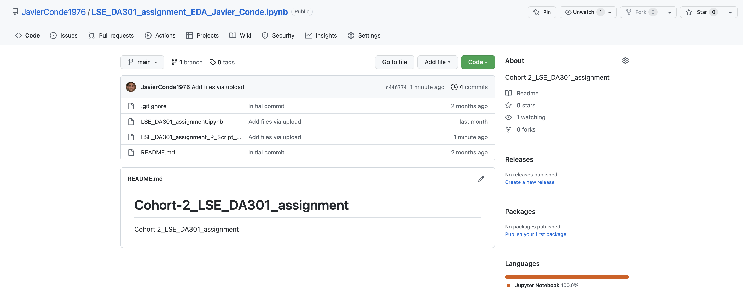
Figure 1.3: Project Github repository (II)
Source: Javier Conde (2022)
Javier Conde | 12th September 2022

Slide 5
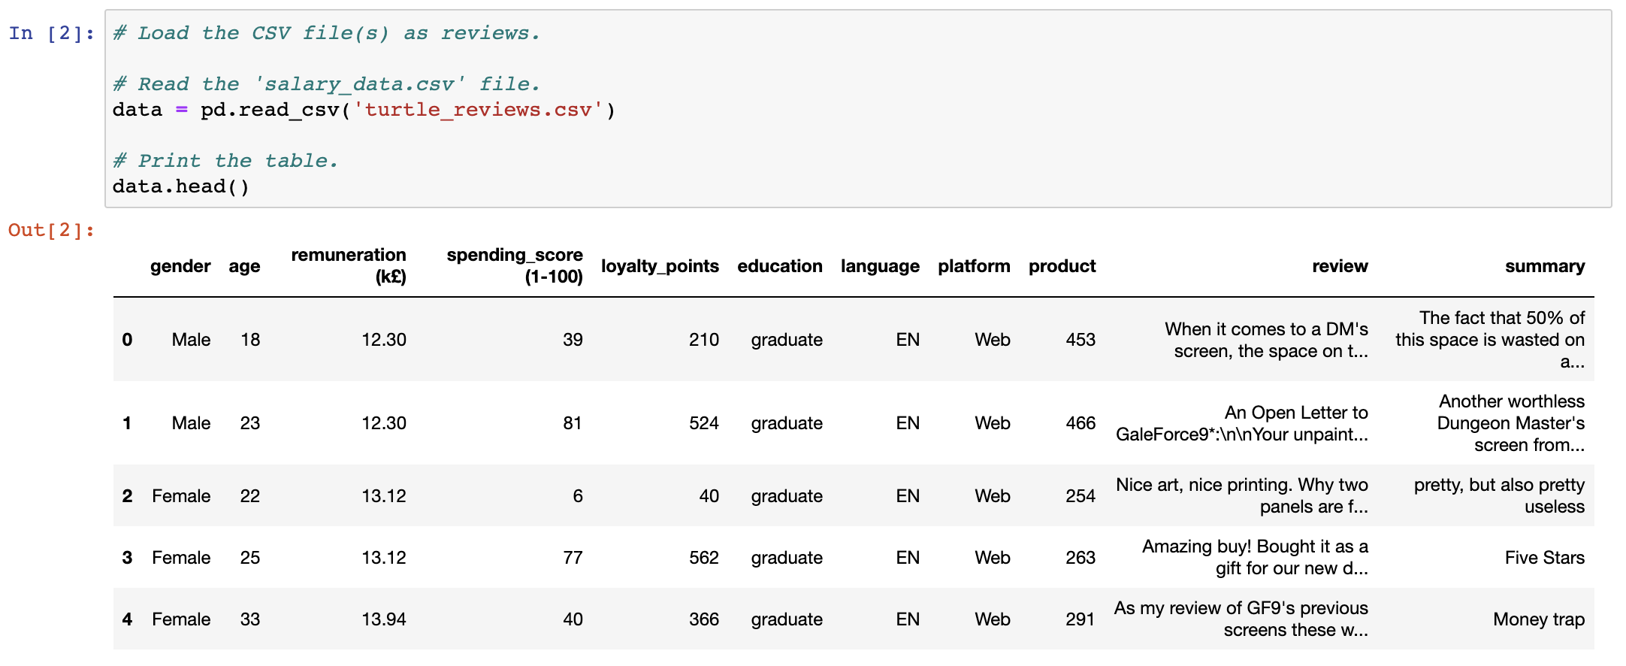
2.1. First approach and insights to provided data
Figure 2.1: Data clean and re-import process (I)
Source: Javier Conde (2022)
Javier Conde | 12th September 2022

Slide 6
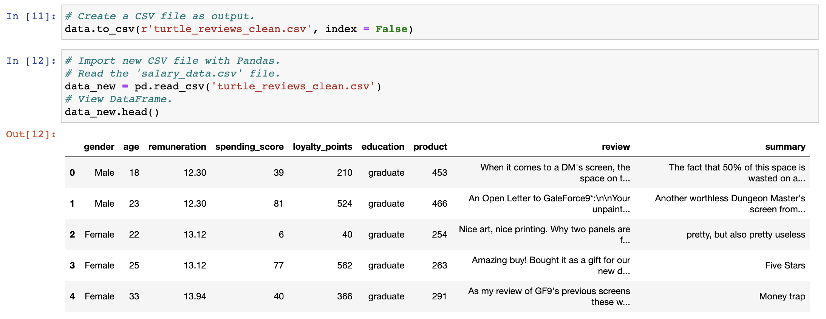
Figure 2.2: Data clean and re-import process (II)
Source: Javier Conde (2022)
Javier Conde | 12th September 2022

Slide 7
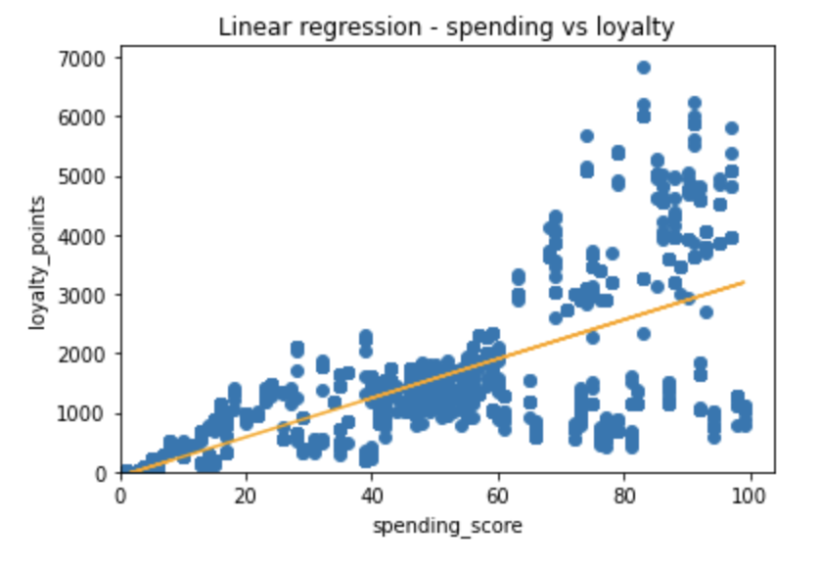
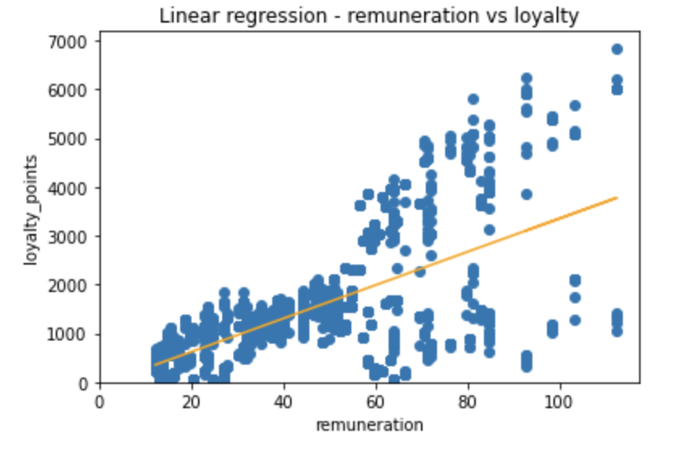
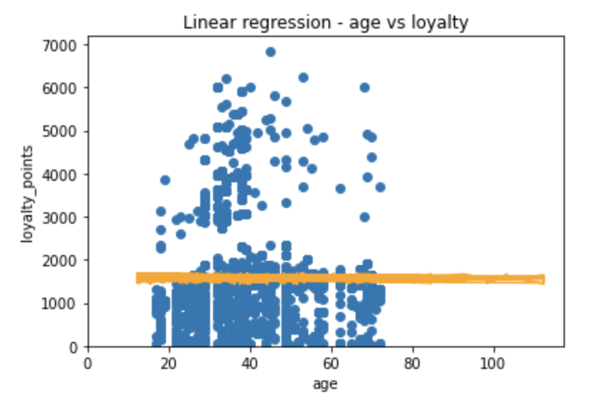
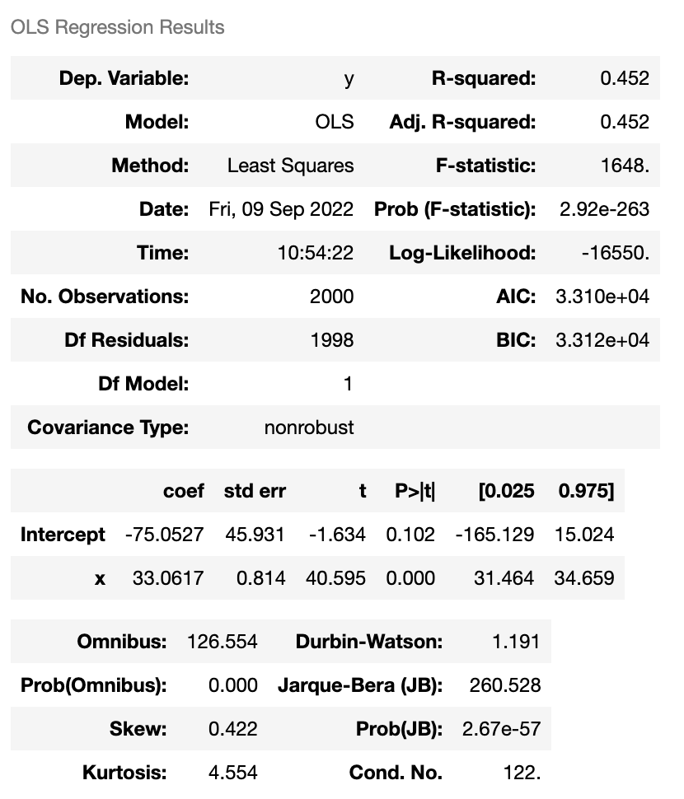
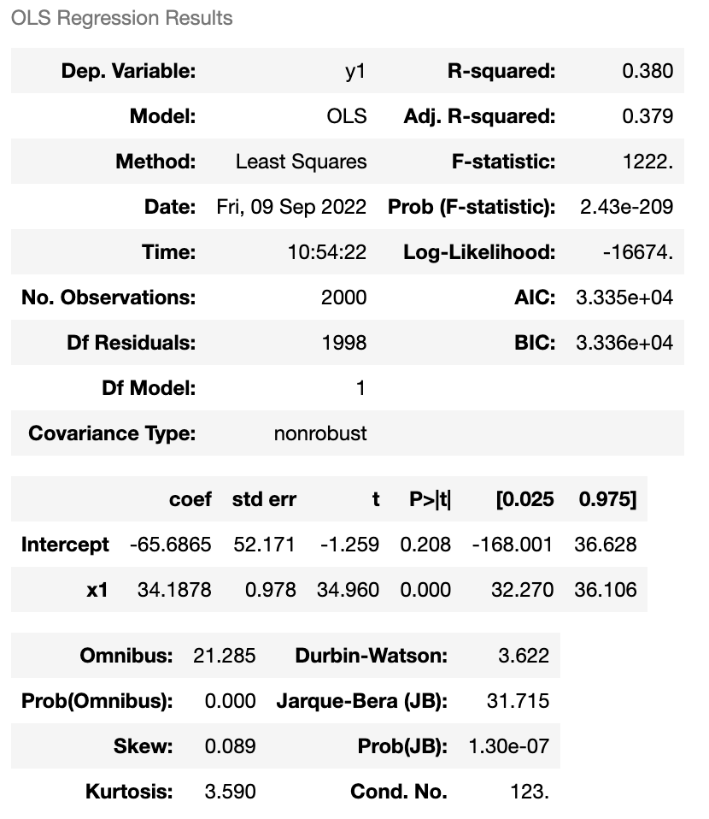
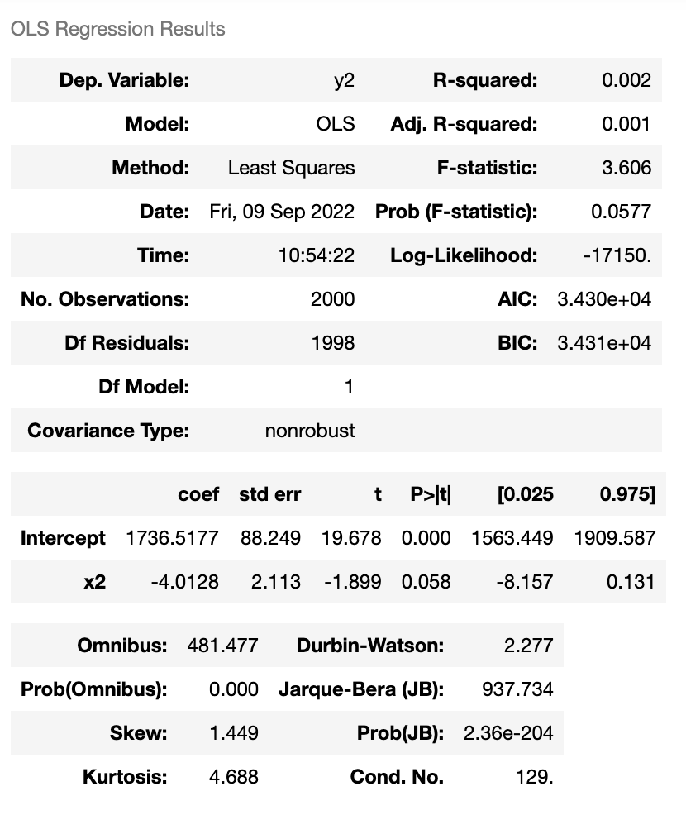
Figure 2.3: Loyalty vs spending, remuneration, age
Source: Javier Conde (2022)
Javier Conde | 12th September 2022

Slide 8
Figure 2.4: First findings
Source: Javier Conde (2022)
GENERAL FINDINGS FROM FILE turtle_review
Loyalty analysis:
There is a slight correlation between spending and remuneration with loyalty (Adjusted R Squared measure 0.45 (spending) and 0.37 (remuneration)) but almost no correlation with age (R2 0.001)). These values suggest a weak correlation between loyalty and spending/remuneration, and no correlation between loyalty/age. Recommendation to the client would be investigating different variables such as customer satisfaction scores.
FINDINGS FROM FILE covid_19_uk_cases.csv
Data cumulative already so no need for extra cumulative calculations
1st case reported in Gibraltar 2020-03-03
Data available only until 14 Oct 2021
Peak in year 2020: 31 December 2040 reported cases; peak 2021: increase of 280% with 5727 reported cases on 14 October (Figure 2.1)
Others’ region may be outlier on ‘Deaths’ (138,237) and ‘Cases’ (8,317,439) columns as very out of range with rest of the regions
FINDINGS FROM FILE covid_19_uk_vaccinated.csv
First vaccinations on 2021-01-11
Data quality questions as possible discrepancies on vaccination info vs real population uncovered: i.e., Gibraltar, 5,606,041 complete vaccination cycle (CVC) on total population of Gibraltar of 33,691 (Figure 2.2) (Source: https://datatopics.worldbank.org/). Cumulative deaths in line with real data (Figure 2.3) (Source: DataCommons.org)
CVC percentage (95.5%) consistent across all United Kingdom provinces
Javier Conde | 12th September 2022

Slide 9
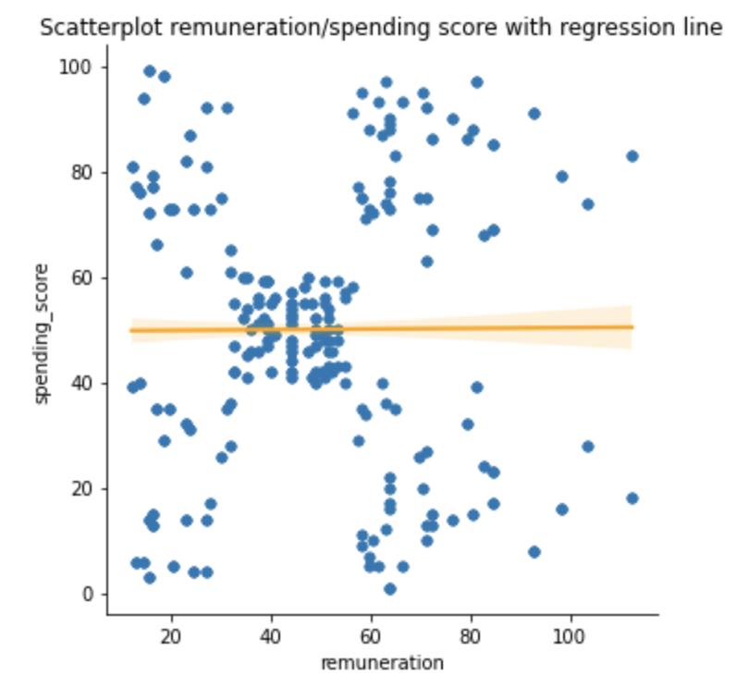
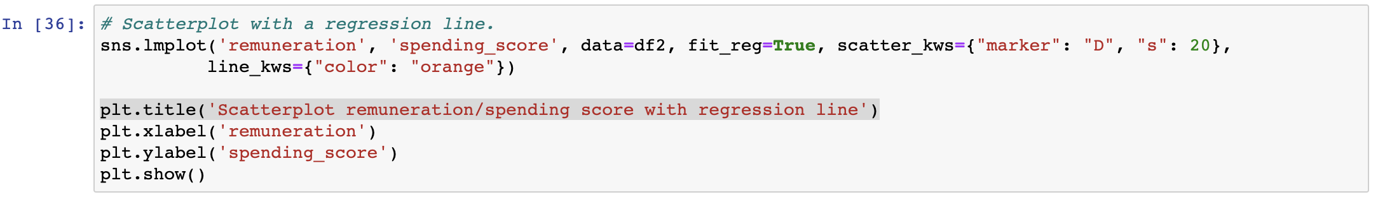
Figure 2.4: Remuneration/spending score Seaborn study: regression scatterplot
Source: Javier Conde (2022)
Javier Conde | 12th September 2022

Slide 10
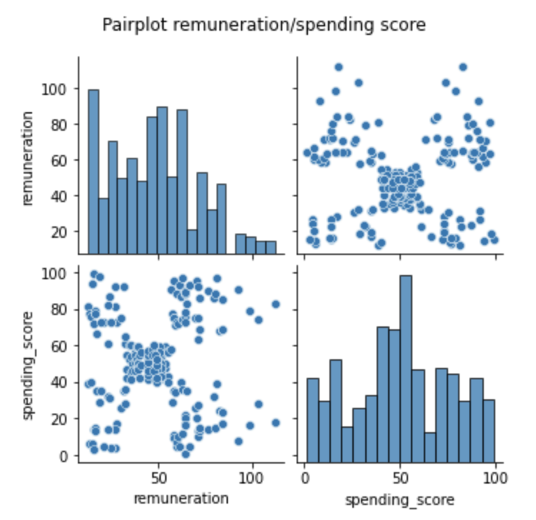
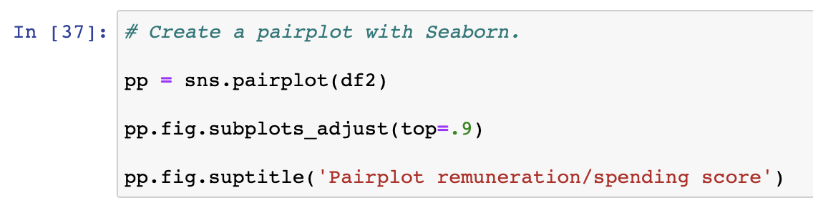
Figure 2.5: Remuneration/spending score Seaborn study: pairplot
Source: Javier Conde (2022)
Javier Conde | 12th September 2022

Slide 11
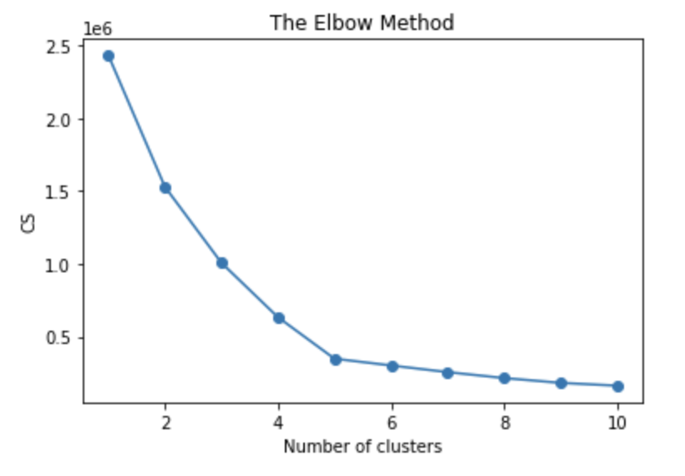
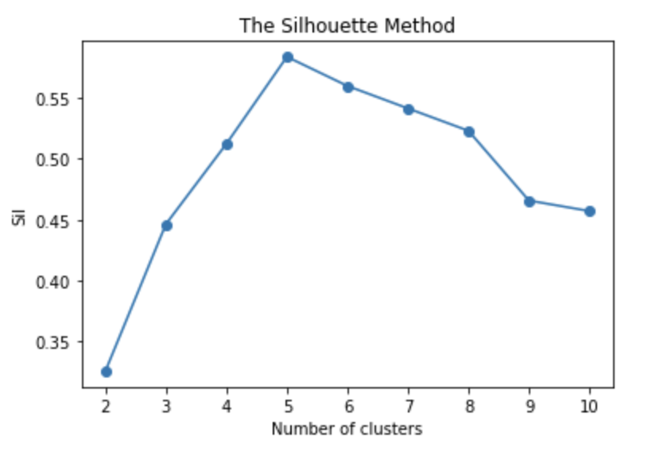
Figure 2.6: k=5 (Elbow and Silhouette methods)
Source: Javier Conde (2022)
Javier Conde | 12th September 2022

Slide 12
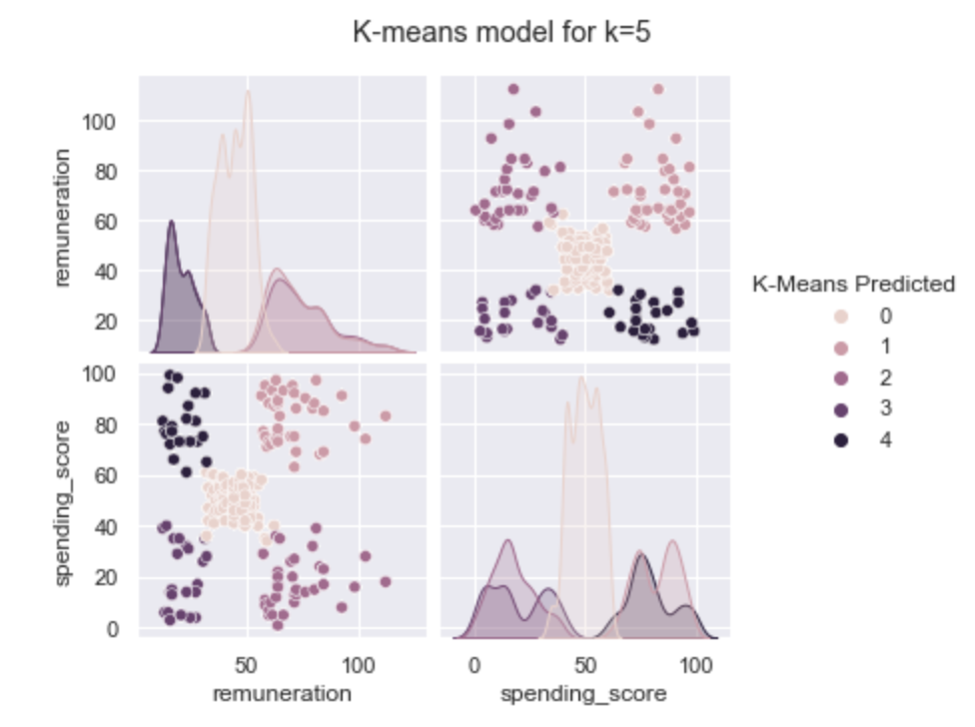
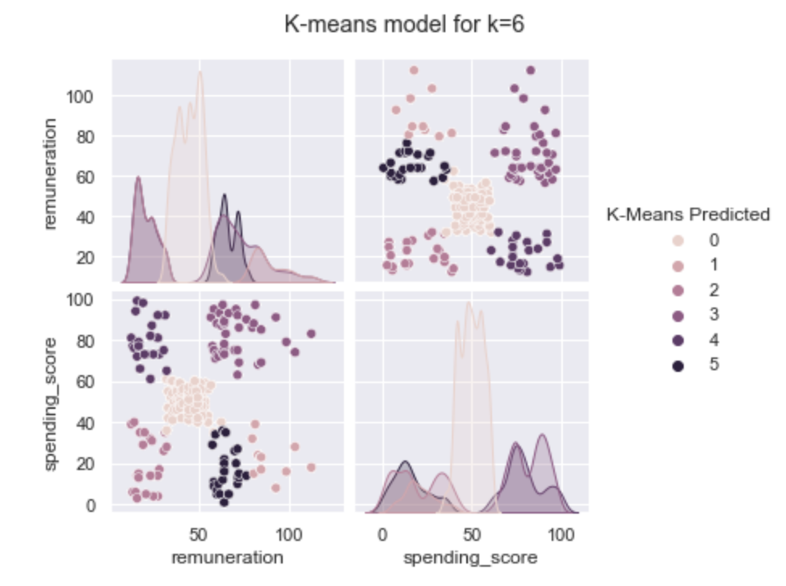
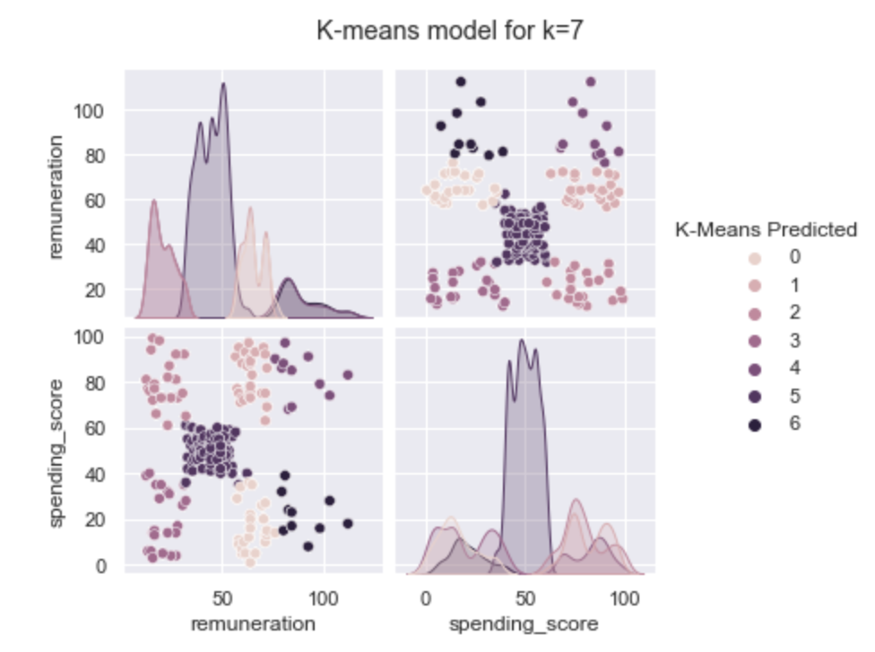
Figure 2.7: K-means model for k=5, k=6, k=7
Source: Javier Conde (2022)
Javier Conde | 12th September 2022

Slide 13
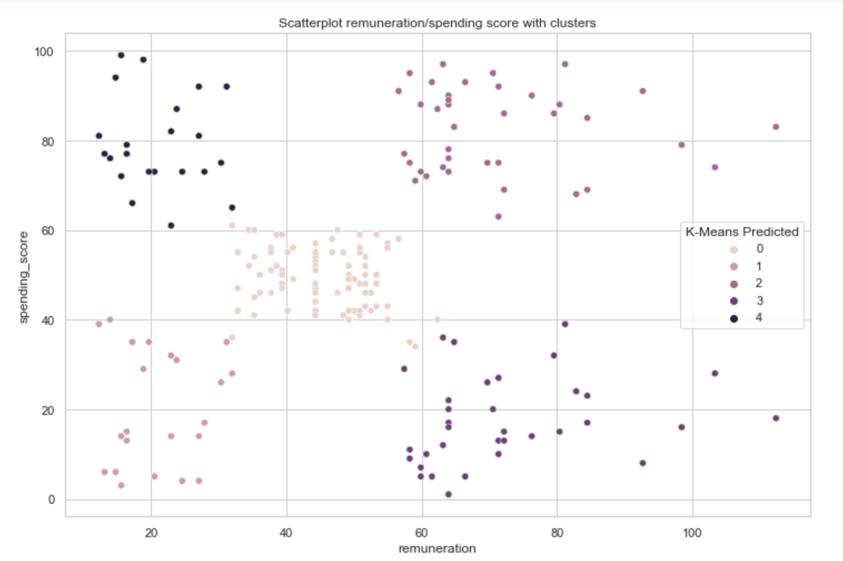
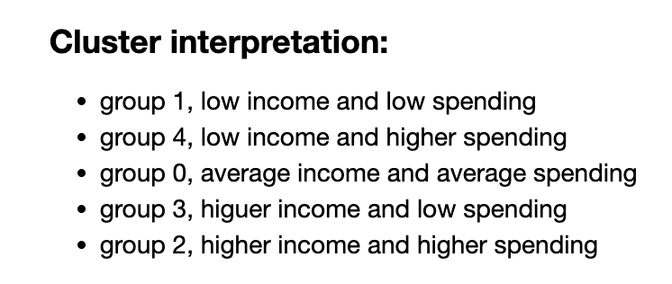
Figure 2.8: K-means chosen model for k=5 with cluster interpretation
Source: Javier Conde (2022)
Javier Conde | 12th September 2022

Slide 14
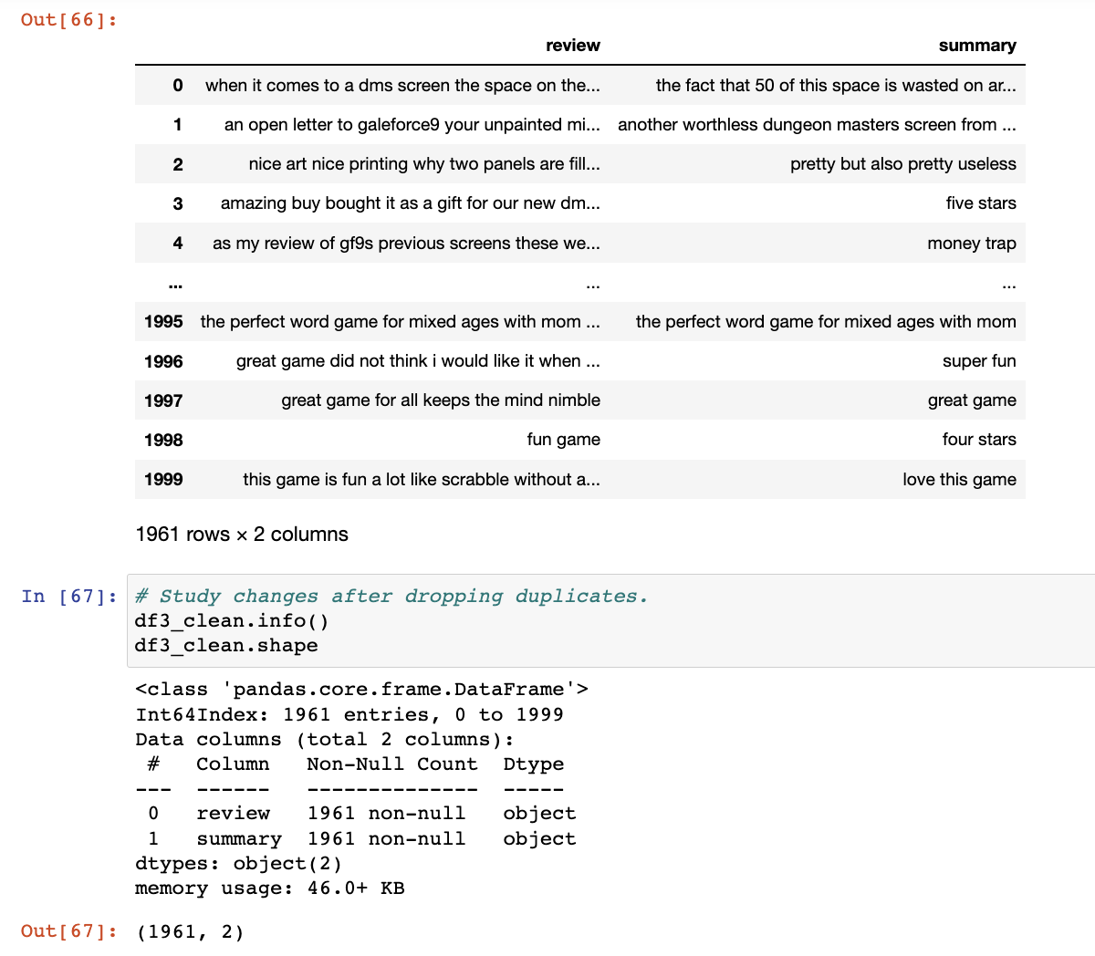
Figure 2.9: Data frame with ‘review’ /‘summary’ columns clean and ready for tokenisation
Source: Javier Conde (2022)
Javier Conde | 12th September 2022

Slide 15
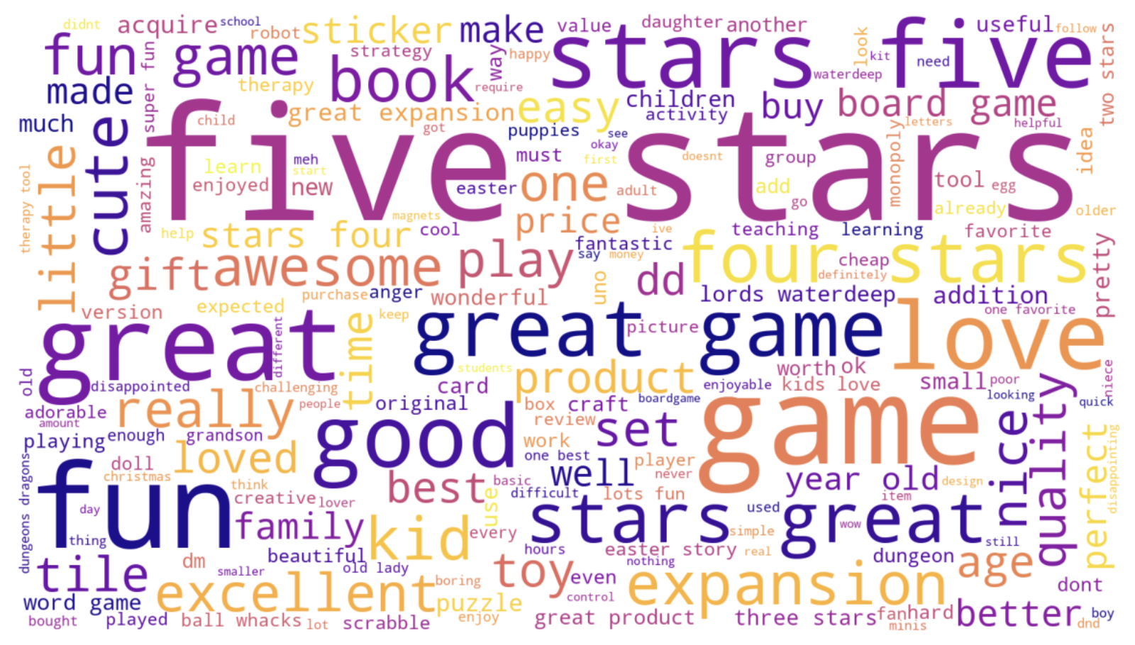
Figure 2.10: Word cloud without stopwords from data frame
Source: Javier Conde (2022)
Javier Conde | 12th September 2022

Slide 16
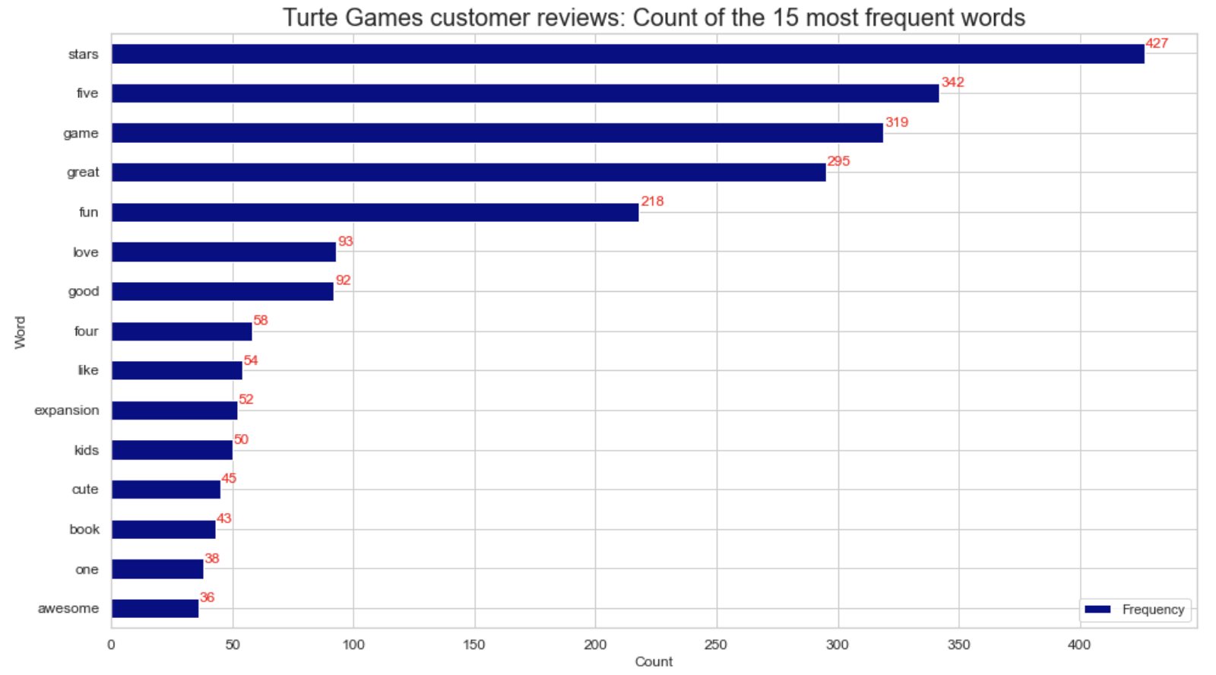
Figure 2.11: Plot for the data frame 15 most frequent words
Source: Javier Conde (2022)
Javier Conde | 12th September 2022

Slide 17
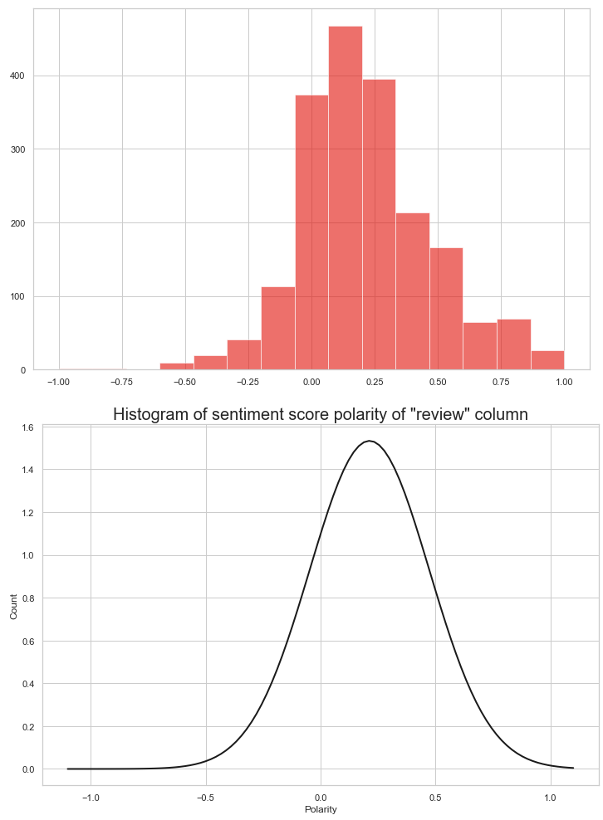
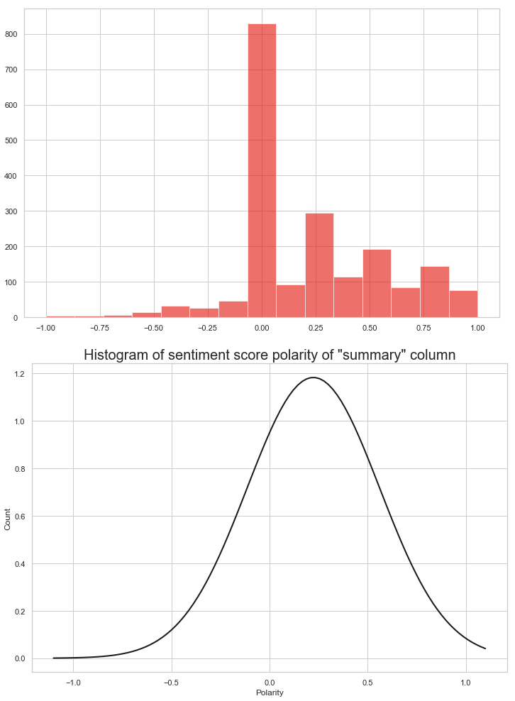
Figure 2.12: Sentiment score polarity analysis for columns ‘review’ and ‘summary’
Source: Javier Conde (2022)
Javier Conde | 12th September 2022

Slide 18
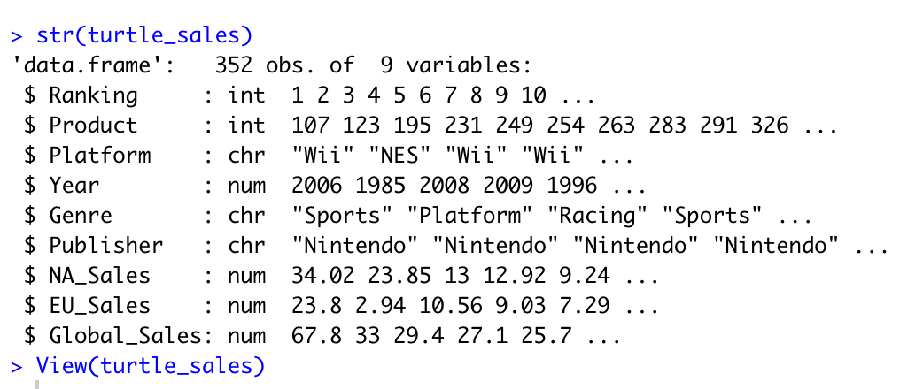
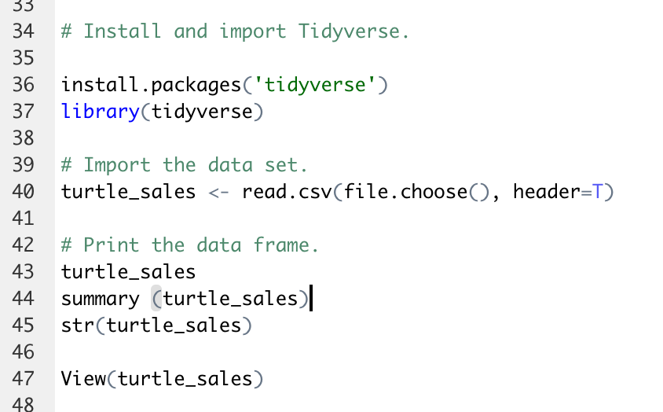
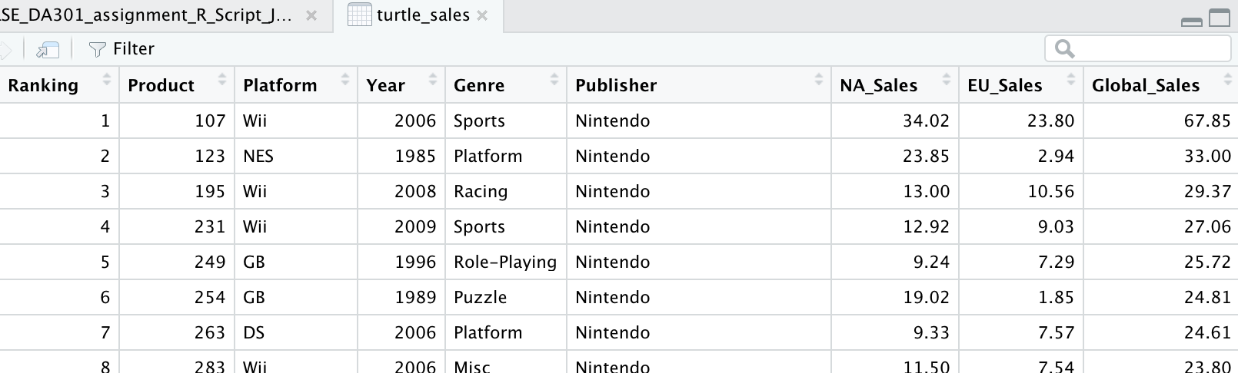
Figure 2.13: Import and exploration of ‘turtle_sales.csv’ provided file
Source: Javier Conde (2022)
Javier Conde | 12th September 2022

Slide 19
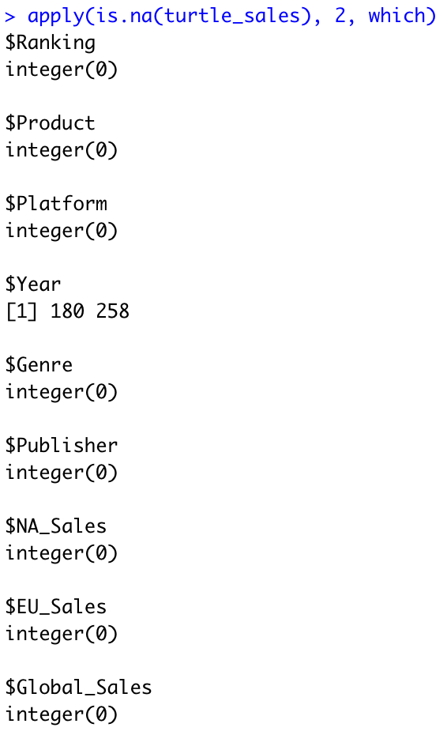
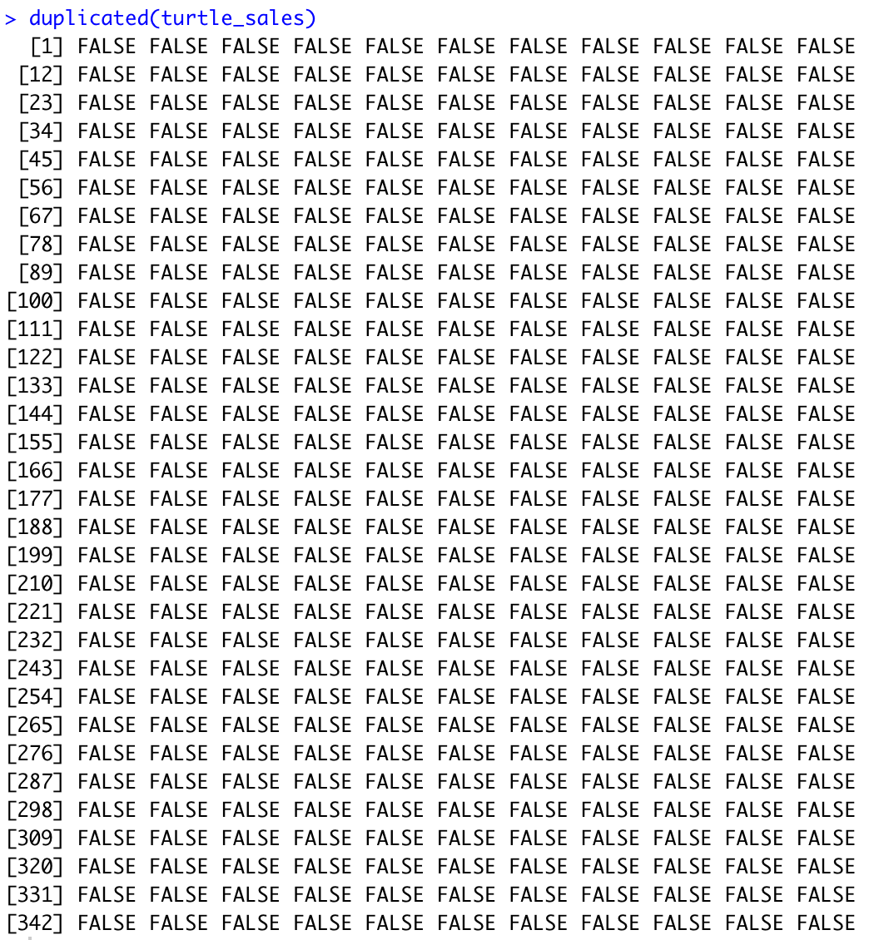
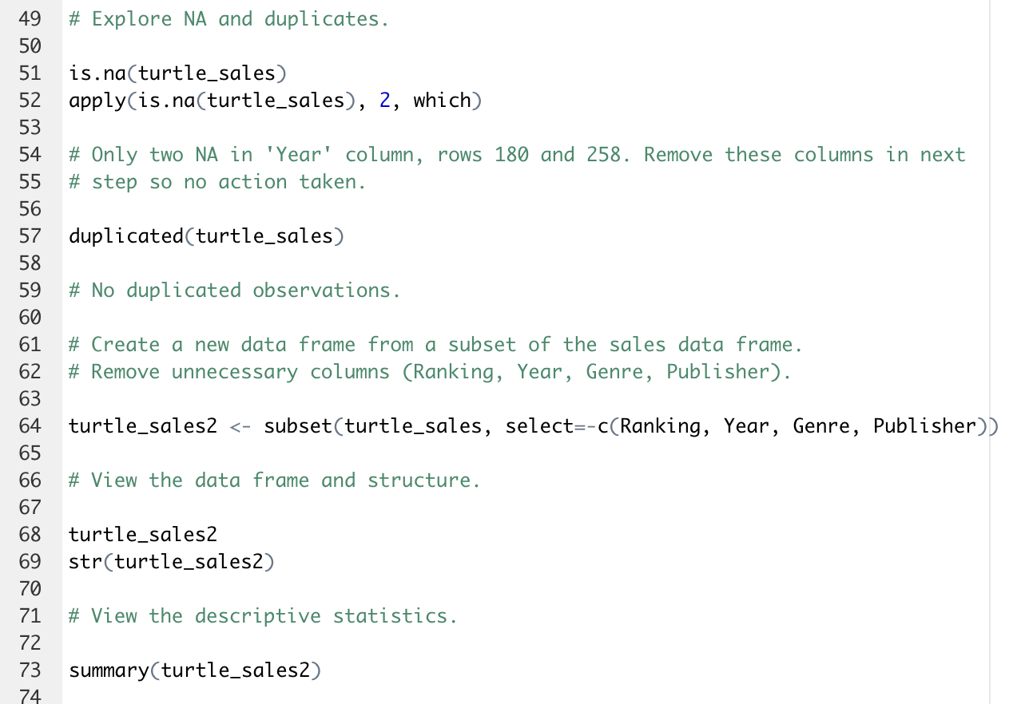
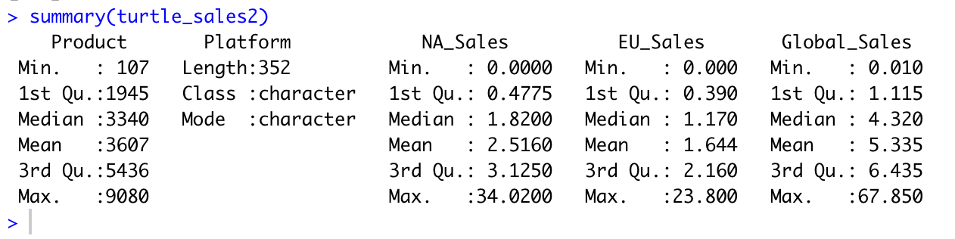
Figure 2.14: Data cleaning and subset creation: NA, duplicated observations, unnecessary columns
Source: Javier Conde (2022)
Javier Conde | 12th September 2022

Slide 20
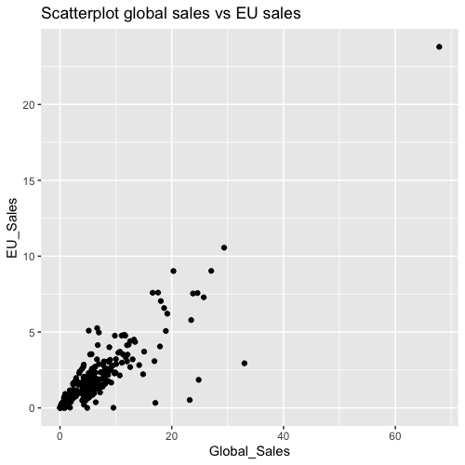

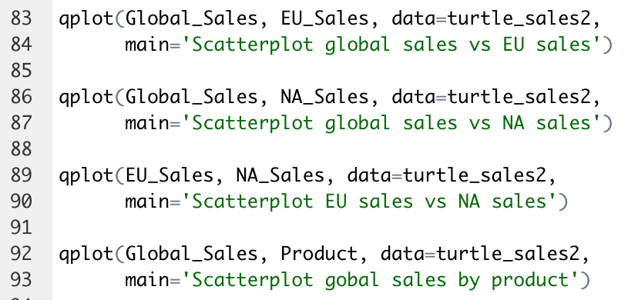
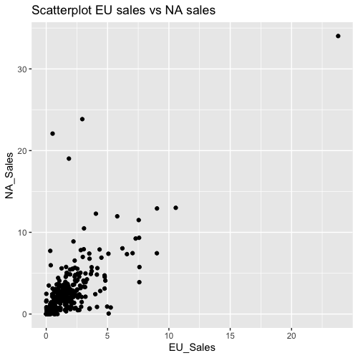
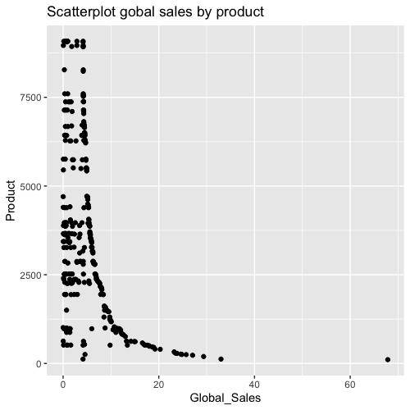
Figure 2.15: Exploratory scatterplots with qplot
Source: Javier Conde (2022)
Javier Conde | 12th September 2022

Slide 21
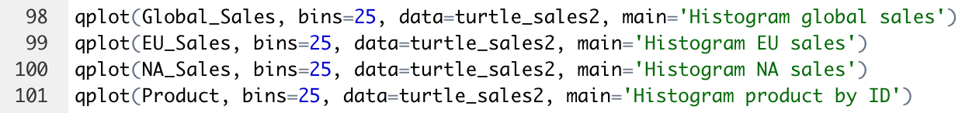
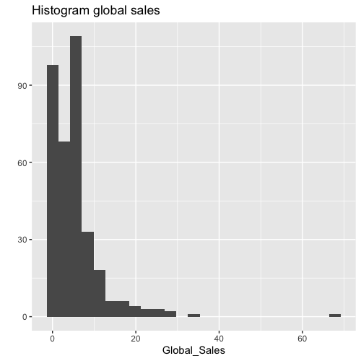
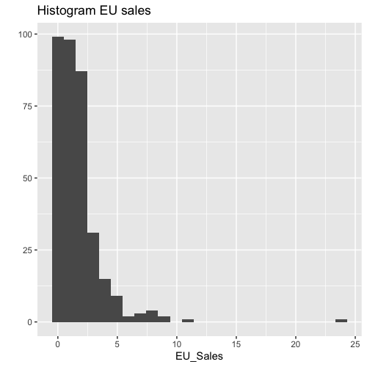
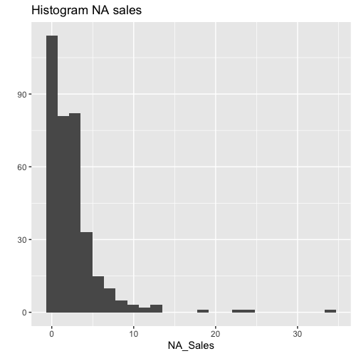
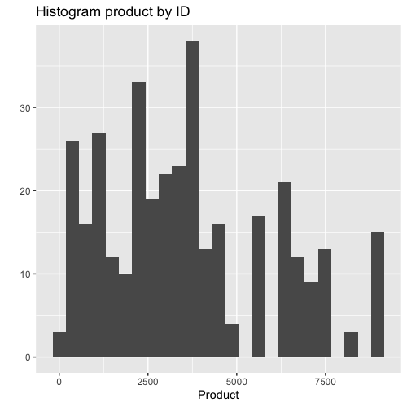
Figure 2.16: Exploratory histograms with qplot
Source: Javier Conde (2022)
Javier Conde | 12th September 2022

Slide 22
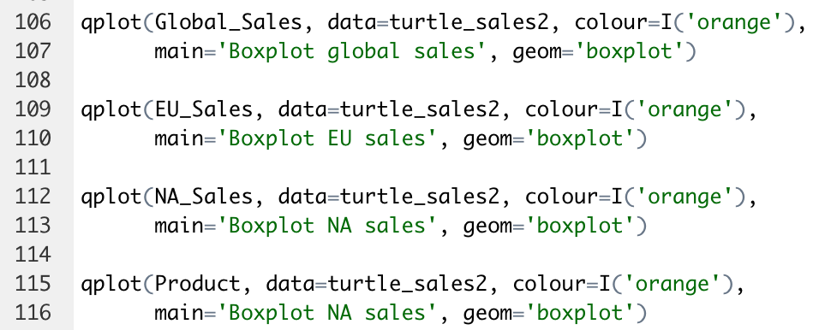
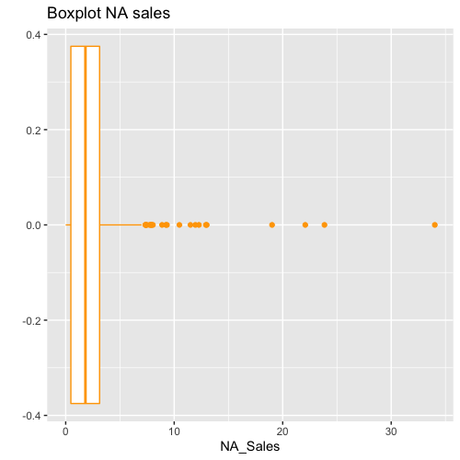
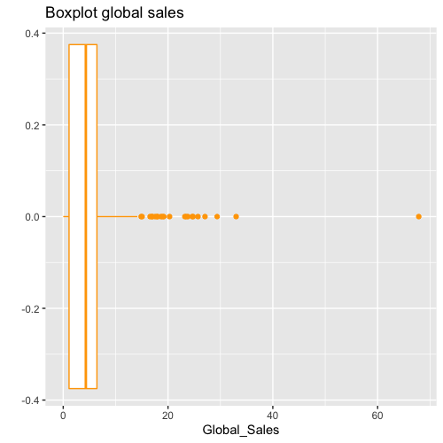
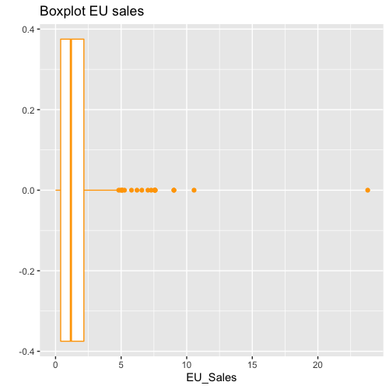
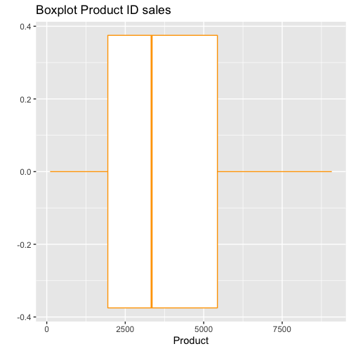
Figure 2.17: Exploratory boxplots with qplot
Source: Javier Conde (2022)
Javier Conde | 12th September 2022

Slide 23
Figure 2.18: First observations and further exploration
Source: Javier Conde (2022)
The ‘turtle_sales’ data set provided is of great data quality (no duplicates, just two NA in ‘Year’ column)
From the initial scatterplot is visible a possible relationship between the variables ‘Global_Sales’ and ‘NA/EU_Sales’
It needs to be studied further if it is possible building a regression model that is robust enough to allow predictive studies on future global sales depending on the observation of EU and NA values.
EU, NA and global sales boxplots reveal quite a number of outliers that would recommended to keep monitored and possibly acted upon if further calculations require using min, max, mean, SD, variance, IR Range, etc.
Histograms reveal possible skewness to the right (positive) of Global, EU, and NA sales. Study on the data set variables’ normality and more advanced and detailed plotting is needed.
Javier Conde | 12th September 2022

Slide 24
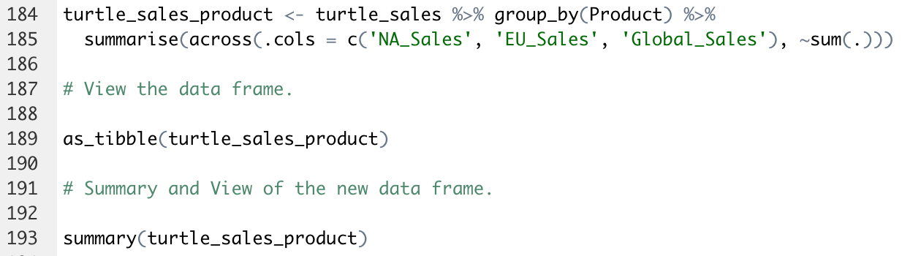
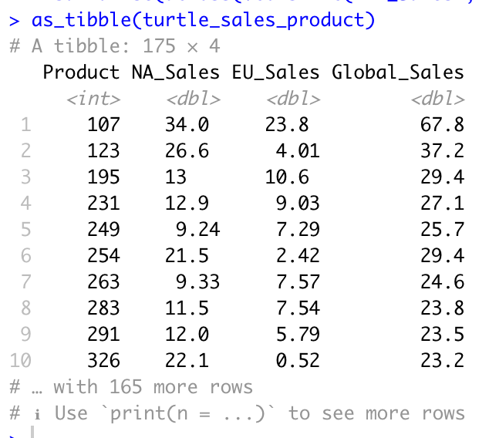

Figure 2.19: Data aggregation by product, overview and summary
Source: Javier Conde (2022)
Javier Conde | 12th September 2022

Slide 25




Figure 2.20: Normality study: QQ Plots
Source: Javier Conde (2022)
Global sales
EU sales
NA sales
Javier Conde | 12th September 2022

Slide 26


Figure 2.21: Normality study: Shapiro-Wilk test
Source: Javier Conde (2022)
Javier Conde | 12th September 2022

Slide 27


Figure 2.22: Normality study: skewness and kurtosis
Source: Javier Conde (2022)
Javier Conde | 12th September 2022

Slide 28


Figure 2.23: Variables correlation
Source: Javier Conde (2022)
Javier Conde | 12th September 2022

Slide 29




Figure 2.24: Advanced plotting (ggplot with linear approach)
Source: Javier Conde (2022)
Javier Conde | 12th September 2022

Slide 30


Figure 2.25: Advanced plotting (ggplot with non linear approach)
Source: Javier Conde (2022)
Javier Conde | 12th September 2022

Slide 31
Figure 2.26: Further findings
Source: Javier Conde (2022)
Grouping data based on product allows exploring easily sales based in product ID
Exploring data set normality through Q-Q Plots, Shapiro-Wilk testing, skewness and kurtosis investigation, variables correlation, and advanced plotting using ggplot:
p-values for sales are way below 0.05 (global 2.2e-16, EU 2.987e-16, NA 2.2e-16)
all three sales variables are skewed to the right/positively skewed (global 3.06, EU 2.88, NA 3.04)
Kurtosis values are way above 3-4 (global 17.7, EU 16.2, NA 15.6) , all a strong departure from normality
It can be concluded that the sales variables, at least per the sample data provided, are not normally distributed
There is a strong correlation between Global_sales and NA_sales (0.92), Global_sales an EU_sales (0.85). Less good correlation exists between EU_sales and NA_sales (0.62)
Advance plotting with ggplot confirms the strong correlation between sales variables. This opens the possibility of building a multiple linear regression model to predict global sales values
Javier Conde | 12th September 2022

Slide 32

Figure 2.27: Simple linear regression model for sales variables (I)
Source: Javier Conde (2022)
Javier Conde | 12th September 2022

Slide 33


Figure 2.28: Simple linear regression model for sales variables (II)
Source: Javier Conde (2022)
Javier Conde | 12th September 2022

Slide 34


Figure 2.29: Simple linear regression model for sales variables (III)
Source: Javier Conde (2022)
Javier Conde | 12th September 2022

Slide 35

Figure 2.30: Subset sales data frame without the product column
Source: Javier Conde (2022)
Javier Conde | 12th September 2022

Slide 36

Figure 2.31: Multiple linear regression model (sales)
Source: Javier Conde (2022)
Javier Conde | 12th September 2022

Slide 37

Figure 2.32: Multiple linear regression model (sales and product ID)
Source: Javier Conde (2022)
Javier Conde | 12th September 2022

Slide 38


Figure 2.33: Value prediction (model A, sales) (I)
Source: Javier Conde (2022)
Javier Conde | 12th September 2022

Slide 39


Figure 2.34: Value prediction (model A, sales)(II)
Source: Javier Conde (2022)
Javier Conde | 12th September 2022

Slide 40

Figure 2.35: Value prediction (model A, sales)(III)
Source: Javier Conde (2022)
Javier Conde | 12th September 2022

Slide 41
Figure 2.18: Further findings and insights
Source: Javier Conde (2022)
Comparisons of cycles on vaccinations (evolution of 1st dose vs 2nd dose rollout) reach peak 4 months apart across the regions, which is in line with expected timelines
Statistical insignificance of the rollout difference between regions (consistent 95.5%)
Saint Helena, Montserrat, Bermuda and Gibraltar provinces with highest death/cases ratio. As only one death reported in both Saint Helena and Montserrat, Bermuda and Gibraltar are the provinces where we would advice to research aiming for a possible marketing campaign
Deaths reaching early plateaus (early 2020) in Channel Islands, Turks, Isle of Man and British Virgin Islands with another increase in early 2021. Stabilisation of reported deaths coincides with rollout of vaccination program.
Highest ratio reported recovered/ reported cases in Falklands (91.3%) and Turks (83.6%), followed by Gibraltar (81.5%) and Virgin Islands (70.23%). To consider when planning for the marketing campaign.
Declining trend on hospitalisation from peak January 2021 while trends reverses with increase of reported recovered from the same date. To consider possible relation with vaccine rollout program.
Only 0.8% of a total of 13,336 #coronavirus tweets analysed have hashtags #vacc-. Possible opportunity to research, moving forward with the marketing campaign, more popular COVID-related hashtags to be associated with (i.e. #COVID19 with 1,632 mentions)
Moving average (MA) techniques can really help with forecasting and visualisation of data trends. Key feature is being able to estimate the error in a possible future prediction.
ADVICE FOR TEAM & STAKEHOLDERS: Always important to keep an eye on data quality, understanding data shape & data types at all times and looking for:
Data types
Inconsistencies in column names
Possible duplicate entries
Inconsistent data entry & spelling
Start looking for possible outliers with the .describe() method)
Ways to improve code quality (PEP8 Style Guide)
Javier Conde | 23rd May 2022

Slide 42
Javier Conde Pascual | 14th April 2022
Thank You

